Slide 1
SIMPLE ATM SIMULATION PROJECT
PRESENTED BY
S.D.V.PRASAD REDDY ( 24KB1A05GP)
S.RAGHAVA (24KB1A05GN)
S.NITHIN KUMAR (24KB1A05GD)

Slide 2
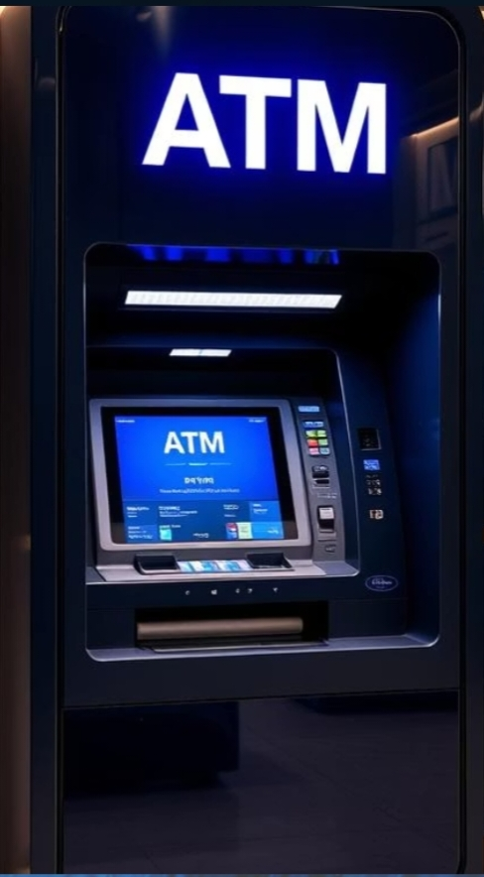

Slide 3
Project Overview
Basic ATM simulation program.
Functions: Check Balance, Withdraw, Deposit.
PIN Authentication.
Balance stored using file I/O (balance.txt).

Slide 4
Key Features
PIN Entry: Secure access with PIN.
Menu Options: Check Balance, Withdraw, Deposit, Exit.
Switch-Case Structure.
File Handling for balance persistence

Slide 5
Program Flow
Start Program
Ask for PIN
If Correct, Show Menu
Process Option (Switch-Case)
Update and Save Balance
Repeat or Exit

Slide 6
SOURCE CODE:
https://onlinegdb.com/fHHaqrrVK

Slide 7
PIN Entry
printf("Enter PIN: ");
scanf("%d", &enteredPin);
if(enteredPin == pin){ ... }

Slide 8
Switch-Case Menu
switch (choice) {
case 1: // Check balance
case 2: // Withdraw
case 3: // Deposit
case 4: // Exit
}

Slide 9
File Handling
FILE *fp = fopen("balance.txt", "w");
fprintf(fp, "%d", balance);
fclose(fp);

Slide 10
File I/O Handling
Save Balance: After withdraw/deposit.
Load Balance: On startup.
File: balance.txt
If missing, creates a new file.

Slide 11
Conclusion
Demonstrates basic ATM simulation.
Implements file operations, input handling, and control flow.
Opportunities for improvement:
Multiple account support, PIN change feature, Enhanced error handling.

Slide 12
THANK YOU

